Slide 1

ABC Poster
Print it, read it and hang it up!
Hang the poster in all departments, so your colleagues easily can learn the ABC codes

Slide 2
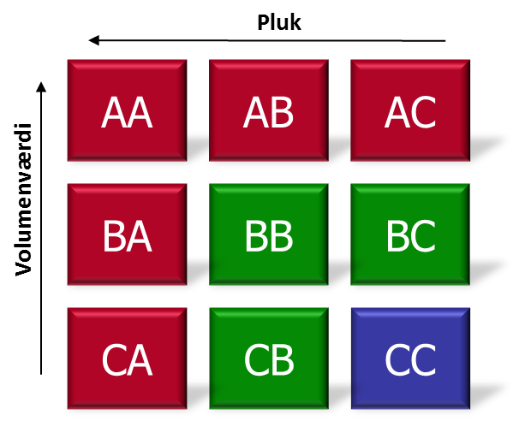
AA
AC
FOCUS
Guidelines
Never out of stock (NOOS)
Dispose daily
Medium order sizes, frequent ordering
Go for high service factor (on-time delivery)
NB
AA are your most important products, avoid stock outs, but don’t purchase excessively (high value)
Remember, products with few customers are high risk
Thresholds
Cost value above XX USD. & more than XX picks per year
RISK
Guidelines
Be careful and control the products manually
Always check up on forecasts before purchasing!
Consider Produce to Order
Focus on return policy
NB
Focus on delivery time instead of price when negotiating with suppliers
Thresholds
Cost value above XX USD. & less than XX ppy
Most important products
High value – many picks
Uncertain products
High value – few picks
Example
Picks
Example
Cost value
CC
CA
Kostværdi
Least important products
Low value – few picks
FASTRUNNER
Guidelines
Buy large amounts when you buy from suppliers
Use simple/automated control
Consider contribution margins vs ordering costs
Go for high service levels (on-time delivery)
NB
These products are low value for your business, but very important to your customers.
Thresholds
Cost value below XX USD. & more than XX picks per year
SLOW
Guidelines
Use the absolute minimum of time possible on these products
Consider alternative products
Go for lowest purchase amounts possible (MOQ)
Consider contribution margins vs ordering costs
NB
These are your “Long tale products.” Consider assortment strategy. Is this product necessary?
Thresholds
Cost value below XX USD. & less than XX ppy
Cheap, popular products
Low value – many picks
Example

Slide 3
AA
AC
FOKUS
Guidelines
NB
Thresholds
Cost value above XX USD. & more than XX picks per year
RISIKO
Guidelines
NB
Thresholds
Cost value above XX USD. & less than XX ppy
Most important products
High value – many picks
Uncertain products
High value – few picks
Add your guidelines and ”Obs” before you print
Insert your limits
Picks
Cost value
CA
Kostværdi
CC
Least important products
Low value – few picks
FASTRUNNER
Guidelines
NB
Thresholds
Cost value below XX USD. & more than XX picks per year
SLOW
Guidelines
NB
Thresholds
Cost value below XX USD. & less than XX ppy
Cheap, popular products
Low value – many picks

